Slide 1

Airfare aggression Analysis
ABHISHEK RAJA 1MS13CS008
ADITHYA 1MS13CS010
AKSHAY P S 1MS13CS019
RAGHAVENDRA 1MS14CS417

Slide 2
Introduction
Why Online Booking of Flight tickets?
It is a better way of booking your travel over the internet which allows convenient online payment for users and allows users to request for a particular seat, special meal or service.
What is that we are trying to achieve?
The already available online booking system does not provide the best offer for the same booking by comparing many other prices of various companies. Hence this new addition can give a whole easy and economical planning of the travel.

Slide 3
Problem statement
Here we try to analyse the airline fare aggression based on various derivatives like:
1)How early tickets are booked.
2)The time of flight.
3)Which day of the week the flight is booked.
Basically we are trying to figure out which Airline company is aggressive in increasing the Airfare

Slide 4
Literature survey
Organizations all over the world are competing through the use of the most comprehensive and advanced technological features.
American Airlines was the first to establish an automated booking system in 1946. The system endured years of development and alterations. In the late 1960s and early 1970s, airlines established their own systems.
United Airlines developed the Apollo Reservation System, and shortly after allowed travel agents access.
Airline deregulation occurred in 1978, magnifying the importance of computerized airline reservation systems and their accessibility. Antitrust laws came into focus.
1978 Airline Deregulation Act in the United States was to eliminate government control over commercial aviation, and ensure competitive behavior and fair business practices in the airline industry
Later people booked with only the available prices and not knowing the cost of other airlines. This project was built to overcome this disadvantage and produce a system that could give a cost benefits to users.

Slide 5
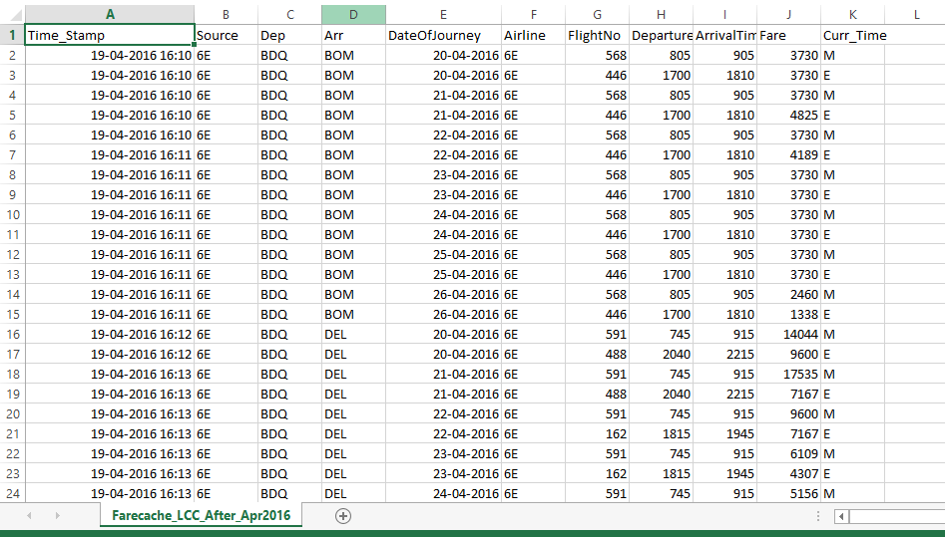
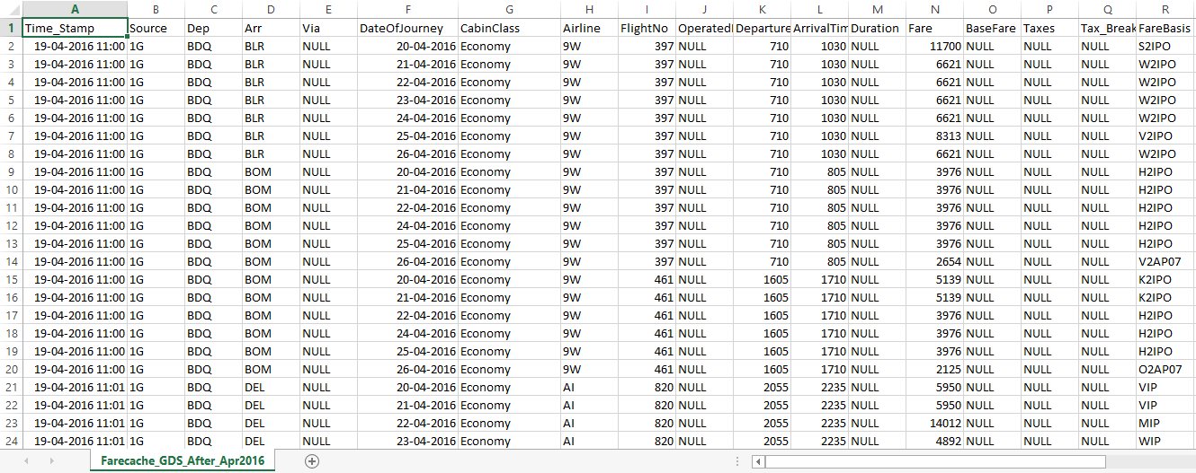
Description about datasets

Slide 6
Data Cleaning was done to remove redundant data points
Important attributes were selected in order to move on with the process of analysis
Important attributes are fare rate, difference in days(booking date and date of journey), current time and day of the week. Fare changed with change of any of these attributes.

Slide 7
Description about srs
Interface Requirements
User Interface – R programming language
Software Interface – Rstudio to execute R codes
Hardware Interface- Rstudio with 2GB of RAM, I3 processor
Storage Interface – Cloud Storage (later extensions)
Communication Interface- A web platform(Connect airlines and customers)

Slide 8
Description about the Design Architecture

Slide 9
ARCHITECTURE DESIGN

Slide 10
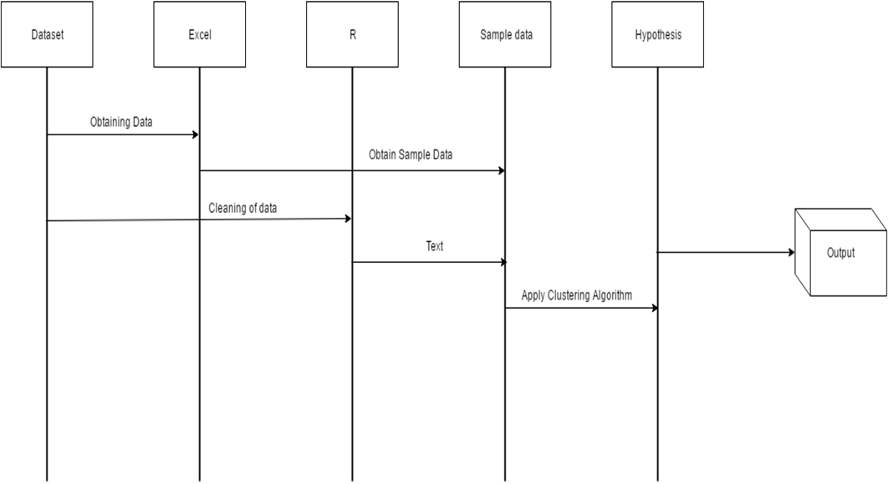
Sequence diagram

Slide 11
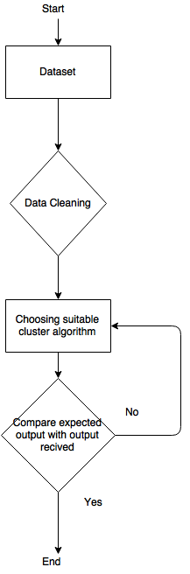
Flow diagram

Slide 12
implementation
Tools used - Rstudio, Excel
Technology – R(programming language)
Algorithm Used - k-means clustering algorithm used to cluster data into 6 categories
Analysis 1 : Unique flights determined based on day of journey, difference in booking date- date of journey and current time is used to cluster data using k-means algorithm.
Analysis 2 : Fare minimum value is calculated for all different flights. For every value in the population, fare change is calculated with respect to the minimum value. Clustering is done to get more accurate results.

Slide 13
results

Slide 14
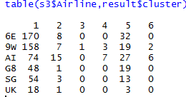
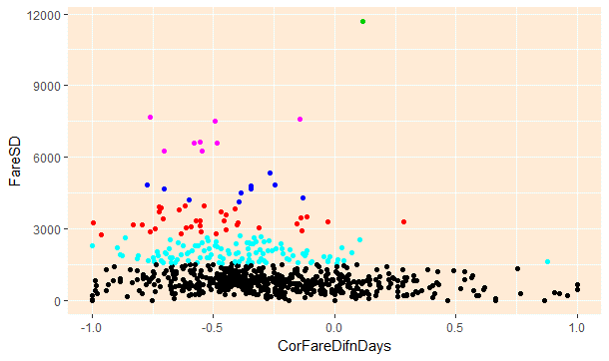
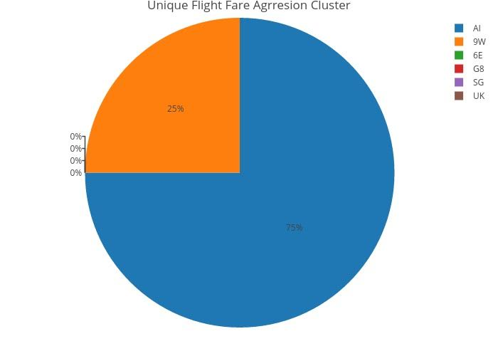
Analysis 1

Slide 15
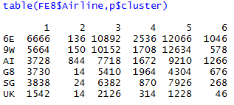
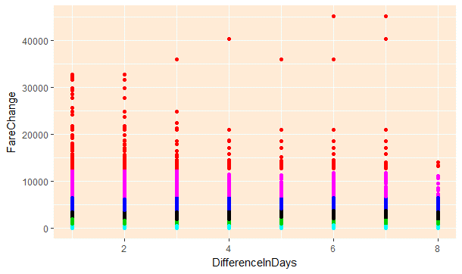
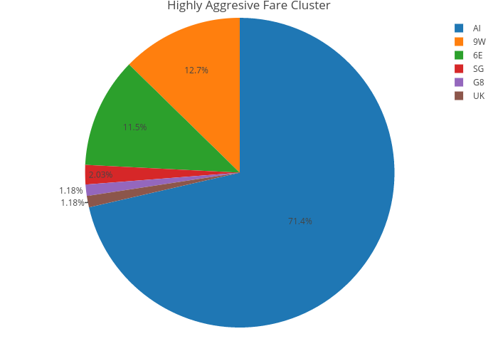
Analysis 2

Slide 16
Conclusion and future work
Successfully built the AIRFARE AGGRESSION ANALYSIS where the best fare for the given travel specification is obtained from the available data of the airlines.
The future work aimed for this project is to enable the AIRFARE AGGRESSION ANALYSIS to advice the customers to choose the best airline that provides least charges for the fly.

Slide 17
bibliography
[1] https://en.wikipedia.org/wiki/Internet_booking_engine
[2] http://www.travelpd.com/travel-portal-agile-methodologies
[3] http://www.airfrance.fr/FR/en/common/transverse/footer/edito_psc.htm
[4] Aksoy, S., Atilgan, E., &amp; Akinci, S. (2003). Airline services marketing by domestic and foreign firms: differences from the customers’ viewpoint. Journal.
[5] The Changing Low-Cost Airline Model: An Analysis of Spirit Airlines David E.Rosenstein.

Slide 18
Thank you

